Slide 1
3D Graphics Recap and DirectX Introduction
Dr David White

Slide 2
Introduction
A recap of 3D graphics concepts, Direct3D vs OpenGL, More about Direct3D
3D Transformation Pipeline
History of DirectX
Programmable Pipelines
Direct3D
The Swap Chain

Slide 3
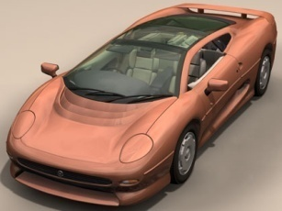

Introduction
Camera paradigm for 3D viewing
3D viewing is similar to taking picture with camera
2D picture
Camera
2D view of 3D scene will depend on:
camera parameters
position, direction, field of view, …
properties of scene objects
illumination, textures...
3D scene

Slide 4
Transformation Pipeline
2D picture
y_{v}
y_{w}
y_{m}
2D device coordinates
x_{v}
x_{m}
z_{v}
(D3D: projection matrix)
z_{m}
x_{w}
3D viewing coordinates
y_{m}
z_{w}
(D3D: view matrix)
x_{m}
3D world coordinates
z_{m}
(D3D: world matrix)
3D modelling coordinates
Generation of picture of mesh models involves sequence (pipeline) of coordinate transformations

Slide 5
Coordinates Overview
Model Coordinates
Hard coded into code, or loaded from a model
Typically centred on origin (0,0,0)
eg Triangle: (0,1,0), (1,0,0),(-1,0,0)
World Coordinates
The world: where the model is in the world
eg. Triangle might be moved to (0,0,100)
Model is moved from model to world using World Matrix (can be called model matrix)

Slide 6
Coordinates Overview
Viewing Coordinates
Where the viewer/camera is located
Position, rotation
View Matrix
2D Coordinates
Where the 3D scene is on the 2D device (monitor)
Might not be visible
Projection Matrix converts from 3D to 2D

Slide 7
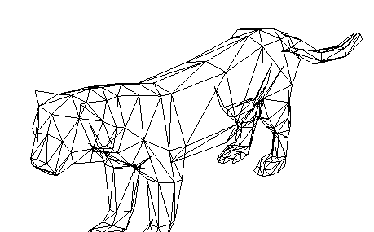

3D Modelling Coordinates
The 3D modelling coordinate system provides a frame for:
specification of object shape
changing size and orientation of individual objects (rotation and scaling)
y_{m}
y_{m}
x_{m}
x_{m}
z_{m}
z_{m}

Slide 8

World Coordinate System
All objects placed in the scene
Different position / orientation / size of scene objects, camera, and lights
y_{w}
y_{v}
Light source
Camera
z_{v}
x_{v}
x_{w}
z_{w}

Slide 9
Viewing Transformation
This is an important concept to grasp:
The camera (viewer) has a position and orientation in the scene
The Viewing transformation moves the world to view space
In view space the camera is at the origin
The View Matrix re-orients the world (at that part in the transformation pipeline) relative to the camera

Slide 10
Viewing Transformation
Simple example:
Camera is pointing up the Z axis
at position (0,0,-100)
Object is at (0,0,10)
In viewspace the camera is at (0,0,0)
In viewspace the object is at (0,0,110)
The view matrix transforms the object into viewspace

Slide 11
Viewing Transformation
y_{v}
y_{w}
x_{v}
y_{w}
y_{w}
z_{v}
Y_{v}
y_{v}
x_{w}
z_{w}
x_{v}
x_{w}
x_{v}
z_{w}
x_{w}
z_{v}
z_{v}
z_{w}
Camera and object / scene
translation
rotation
(1st transformation)
(2nd transformation)

Slide 12
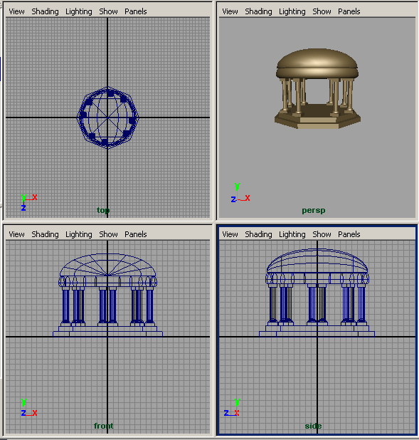
Projection Transformation
Viewing coordinates are mapped onto a 2D view window using projection
Map object in 3D view space to pixel in 2D screen space
2D coordinates given by intersection between view window and ‘rays’ from object towards view plane
The two main types of projection in common use are
parallel projection
perspective projection

Slide 13
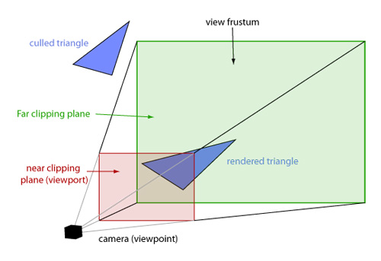
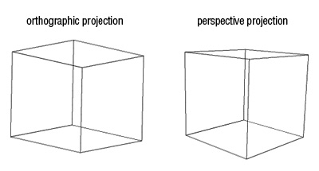
The Virtual Camera
The camera specifies what part of the 3D world the viewer can see
Defines the volume of space that is visible, called the frustum
Defined by the field of view angles and the near and far planes

Slide 14
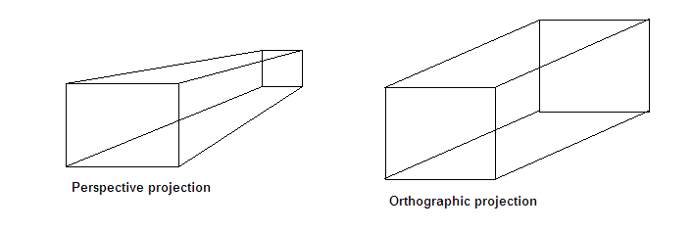
Perspective & Parallel Projection
Perspective - represents 'real' world
Objects far away are smaller to the viewer
Parallel (Orthographic)
Objects far away are the same size (but still behind near objects)
Consider CAD drawings where projection (distance = smaller) would be an issue
Useful for pseudo 2D (drawing flat 3D objects in a 3D world) https://youtu.be/D-cv2wOYUYk

Slide 15
Transformation Pipeline
How is all that achieved?
Each model has a World (or Model) matrix
Camera has a View matrix
Screen / Display has a Projection matrix
We create a WVP (or MVP) matrix:
WVP = World * View * Projection matrices
We use this to transform each vertex position in a vertex shader

Slide 16
Introduction to DirectX
Microsoft DirectX is a collection of APIs for handling tasks related to multimedia, especially game programming and video, on Microsoft platforms
Platforms include Windows 7, 8, 10, Xbox, Xbox 360, Xbox One
Used in many commercial games engines
Cryengine
Unreal Engine
RAGE (Grand Theft Auto 4)
Used for every game on the Xbox One, many games on the PC

Slide 17
DirectX vs OpenGL
DirectX is more than just a graphics API. DirectX has an entire toolkit for sound, music, input, networking, and multimedia.
OpenGL is strictly a graphics API
DirectX is a proprietary API from Microsoft, OpenGL is an open standard

Slide 18
DirectX vs OpenGL
Direct3D is the part of DirectX which handles 3D graphics
Generally, whatever you can do in Direct3D you can do in OpenGL (maybe using a different method)
and vice-versa
Which one to choose?

Slide 19
DirectX vs OpenGL
This course - Direct3D
XBox One, Direct3D
PS4 uses a kind-of Direct3D (as well as OpenGL)
Mobile (iOS / Android) - OpenGL-ES
Windows PC - OpenGL, Direct3D
Linux, Mac - OpenGL (Mac has others too - Metal)
OpenGL is more universal
But having experience of DirectX / Direct3D is *very* useful. *Lots* of companies use it.

Slide 20
History of DirectX
First released in 1995 for Windows 95
Games programmers liked MS-DOS as it allowed direct access to devices, whereas Windows 95 restricted access due to its protected memory model
Microsoft needed a way to let programmers get what they wanted, and created the DirectX API as a way to achieve this

Slide 21
DirectX Versions
Currently used versions are 11 and 12
Unlike previous iterations, 12 is not a simple replacement for 11 - it is a whole new paradigm
12 doesn't replace 11 in the same way 11 replaced 10
A lot more responsibility is given to the developer to manage the GPU / rendering process
It is more difficult to learn
Games companies use both (one or the other)

Slide 22
DirectX 11
11 will be taught on this course
Learning 11 is 'simpler' (for a given value of simple!) and will provide knowledge to learn 12

Slide 23
Fixed vs. Programmable Pipelines
Fixed pipeline
Uses render states to define drawing of geometry
Inflexible due to fixed number of states
Essentially: here's a bunch of triangles, here's a light, please render them with Gouraud Shading
Programmable pipeline
We create render states
Execute on the GPU
Able to create new effects
Developer has control over vertex and pixel shading - do whatever you want

Slide 24
Fixed vs. Programmable Pipelines
DirectX 10 and onwards no longer uses the fixed pipeline
OpenGL has gone down this path too
This means you need to write all lighting and shading code, but you have more control.
For Gouraud shading for example, you would write the calculations for each pixel

Slide 25
Programmable Pipeline
Uses vertex and pixel shaders
Vertex Shader
Program executed on the GPU that operates on each vertex of each model
Calculates world, view, and projection transformations
Using a WVP matrix
Vertex lighting etc
Pixel Shader
Program executed on the GPU that operates at the pixel level
Each pixel on a triangle composed of 3 vertices
Gets passed interpolated vertex data
Generates the colour of a pixel
Can perform alpha tests, depth tests, stencil tests etc

Slide 26
Programmable Pipeline
Shaders can perform multiple passes, and also have multiple techniques for hardware with different capabilities
Eg. NVidia graphics card drivers might have extensions which allow you to do something
such as optimising calculations
https://developer.nvidia.com/unlocking-gpu-intrinsics-hlsl
not required for this module!

Slide 27
Direct3D 11 Pipeline
The graphics (or rendering) pipeline is different to the transformation pipeline
By the time the rendering pipeline starts, the transformation pipeline for that frame should have completed
View, Projection and World matrices will have been calculated, ready to use
It takes as its input: textures, matrices, vertex and pixel shaders (and others)
And outputs pixel colours (for display on a screen or to a render target)

Slide 28
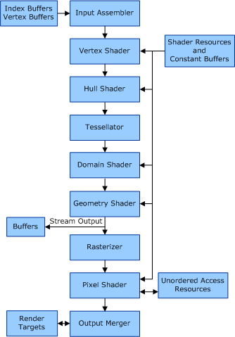
Direct3D 11 Pipeline

Slide 29
Direct3D
Direct 3D is a low-level graphics API that enables us to render 3D worlds using 3D hardware acceleration
Direct3D provides the software interfaces through which we control the graphics hardware
eg ID3D11DeviceContext::ClearRenderTargetView

Slide 30
Direct3D
Direct3D makes our code hardware independent
A Direct3D 11-capable graphics device must support the entire Direct3D 11 capability set
Older versions of Direct3D (eg 9) devices only had to support a subset of capabilities
Device capability checking is no longer necessary in Direct3D11 - you can assume it will support all
(DX Resource Limits) https://bit.ly/2IS6xHk

Slide 31
Hardware Abstraction Layer (HAL)
The HAL is an intermediate step between Direct3D and the graphics device
Direct3D cannot interact directly with the graphics device due to individual hardware differences
HAL is the set of device-specific code that instructs the device to perform an operation
Avoids Direct3D having to know about every graphics card

Slide 32
Conclusion
We are going to learn 3D programming in Direct3D 11
It is a very useful skill to learn
Understanding both OpenGL and Direct3D is highly valued in industry
It also helps you to understand 3D programming better
learning one makes learning the other relatively simple

Slide 33
Required Reading
Introduction to 3D Game programming with DirectX 11
Frank Luna
Chapter 6: The rendering pipeline
Chapter 7: Drawing in Direct3D

